Slide 1
Unit 2
What time do you go to school?
Section B 2a-2c

Slide 2
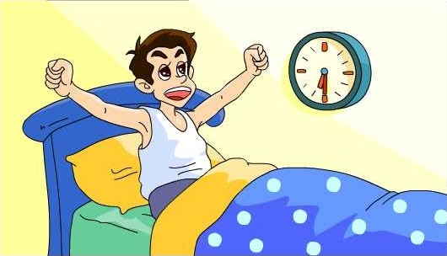
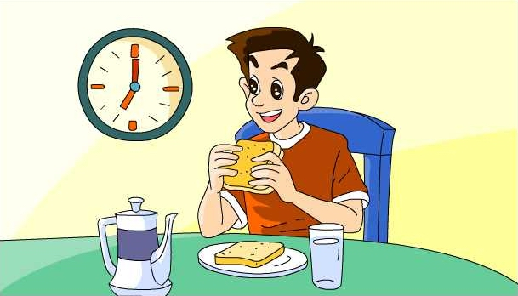
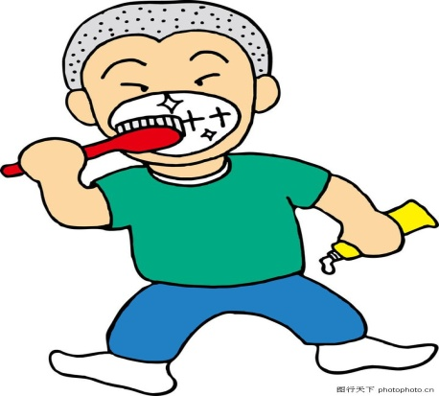
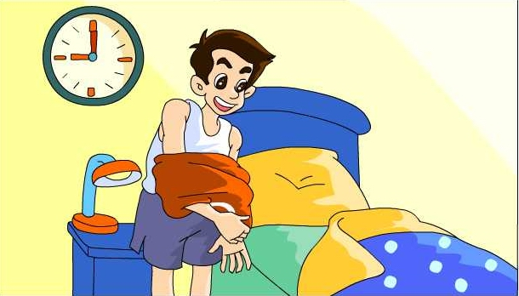
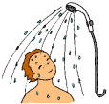
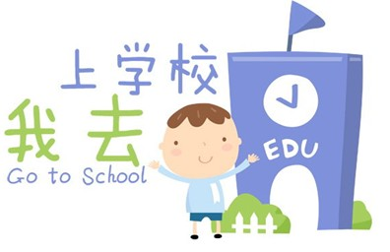
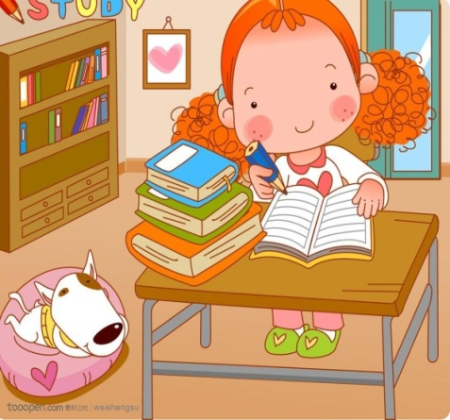
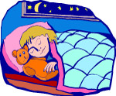
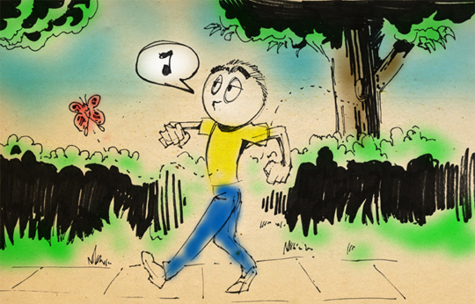
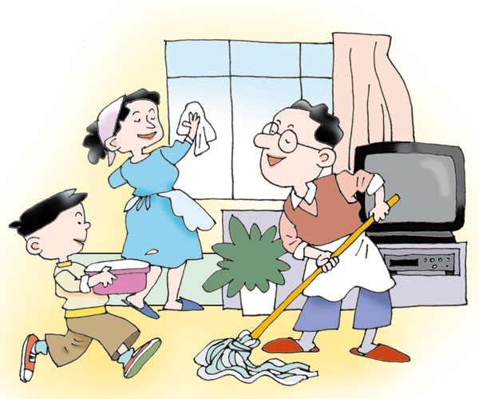
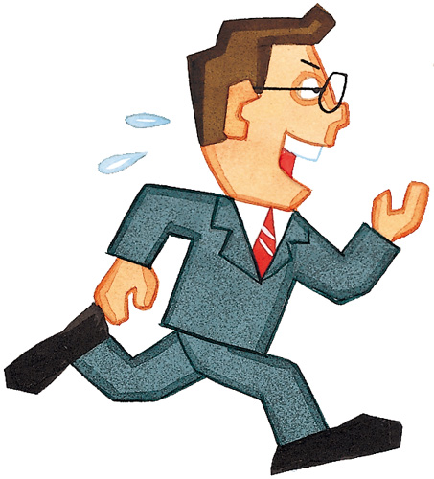
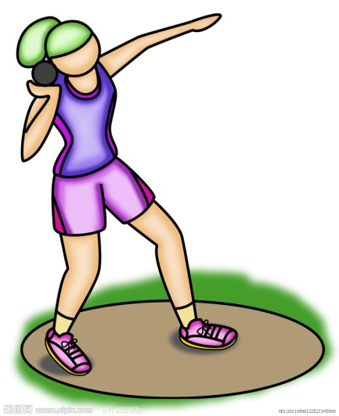

Slide 3
quickly
either
either…or…
lot
lots of
adv. 很快地
adv. 或者；也(用在否定词组后)
要么……要么……；
或者……或者……
pron. 大量；许多
大量；许多

Slide 4
sometimes
taste
life
adv. 有时；间或
v. 有……的味道；品尝
n. 味道；滋味
n. (pl. lives)生活；生命

Slide 5
Check the activities you think are healthy.
2a
√
__ go to bed early __ eat ice-cream
__eat quickly __ eat vegetables
__ play sports __ take a walk
√
√
√
2b
Tony and Mary are brother and sister. They have healthy and unhealthy habits. Who is healthier? Circle the healthy activities.

Slide 6
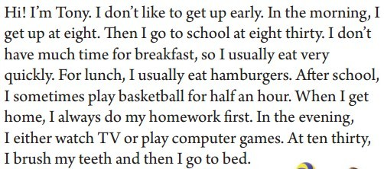
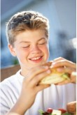

Slide 7
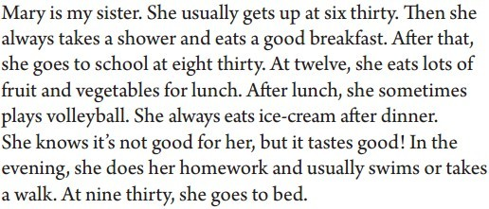
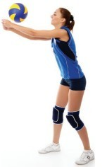

Slide 8
2b Read the passage. Find the
answers to the questions.
1. Who is healthier, Tony or Mary?
2. When does Tony go to bed?
3. When does Mary go to bed?
Mary.
At ten thirty.
At nine thirty.

Slide 9
Read 2b again and fill in the blanks.
Time | Tony's Activities
At eight | __________
 | eats a quick breakfast
At eight thirty | ________________
At noon | ________________
After school | ________________________________
 | __________________
In the evening At ten thirty | ______________________________
 | brushes teeth and goes to bed
gets up
goes to school
eats hamburgers
plays basketball for half an hour
does his homework
watches TV or plays computer games

Slide 10
Time | Mary's Activities
___________ | gets up
 | takes a shower and eats a good breakfast
___________ | goes to school
At twelve | ___________________________
After lunch After dinner | ______________
 | ______________
In the evening At nine thirty | _________________________________________
 | goes to bed
At six thirty
At eight thirty
eats lots of fruit and vegetables
plays volleyball
eats ice-cream
does her homework, swims or takes a walk

Slide 11
2c
Write down the unhealthy habits of each person. Then think of healthy activities for them.
 | Unhealthy habits | Healthy activities
Tony
Mary
play basketball
get up late
have breakfast quickly
do homework first
usually eat hamburgers
brush teeth
eat ice-cream after dinner
take a shower and eat a good breakfast

